Slide 1
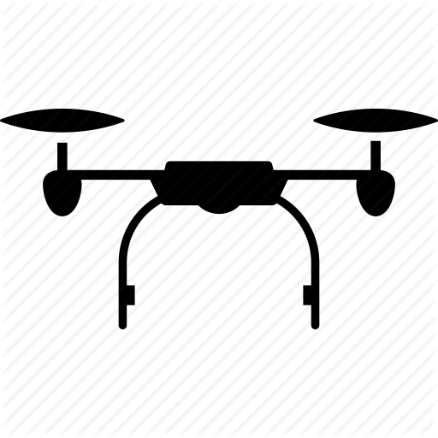

D – Penetration Depth
grass
sand
D
clay

